Slide 1

Tools for Data Visualization
Aula 01:
slide creeds: Dr. Benjamin Bach
Estanislau Lima
15/05/2024
Aula 04

Slide 2

Data Creation Exploration Presentation Visualization

Slide 3


















Slide 4
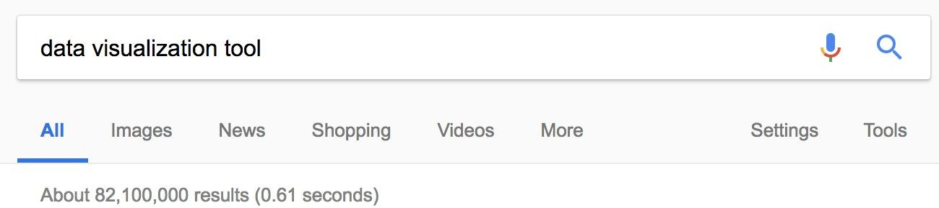
Data Visualization Tools
Visualizations
Accessibility
Learnability
Data format(s)
Aesthetics
Interaction, publication, recycling,...
Performance
Programming skills

Slide 5
Choosing a tool?
What can the tool do?
How much do I have to do?

Slide 6
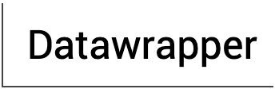

Generic
Coding
Designing
Using
Speciﬁc

Slide 7
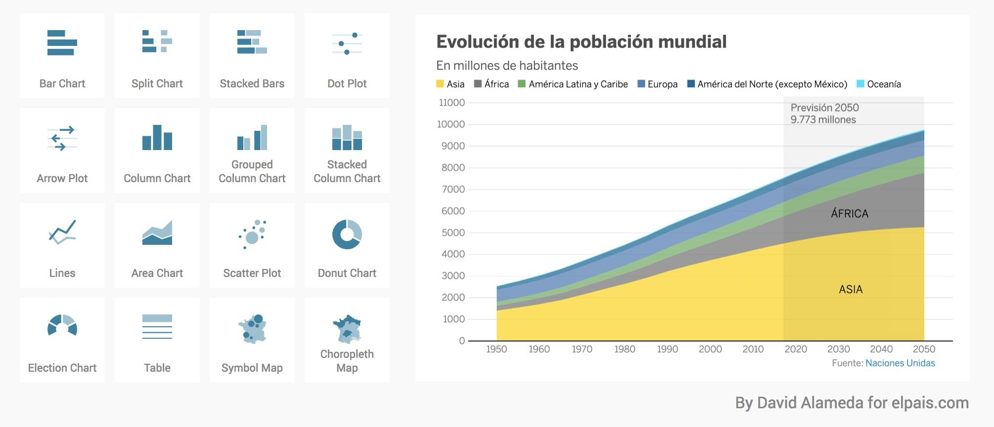
Data Wrapper
https:/ www.datawrapper.de/

Slide 8
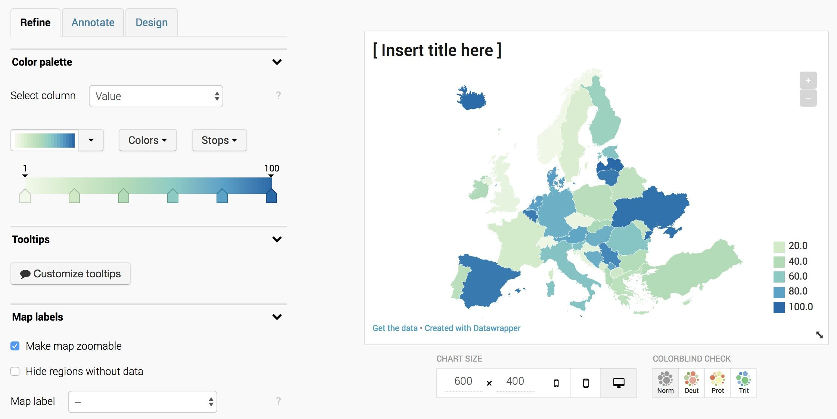
DataWrapper

Slide 9
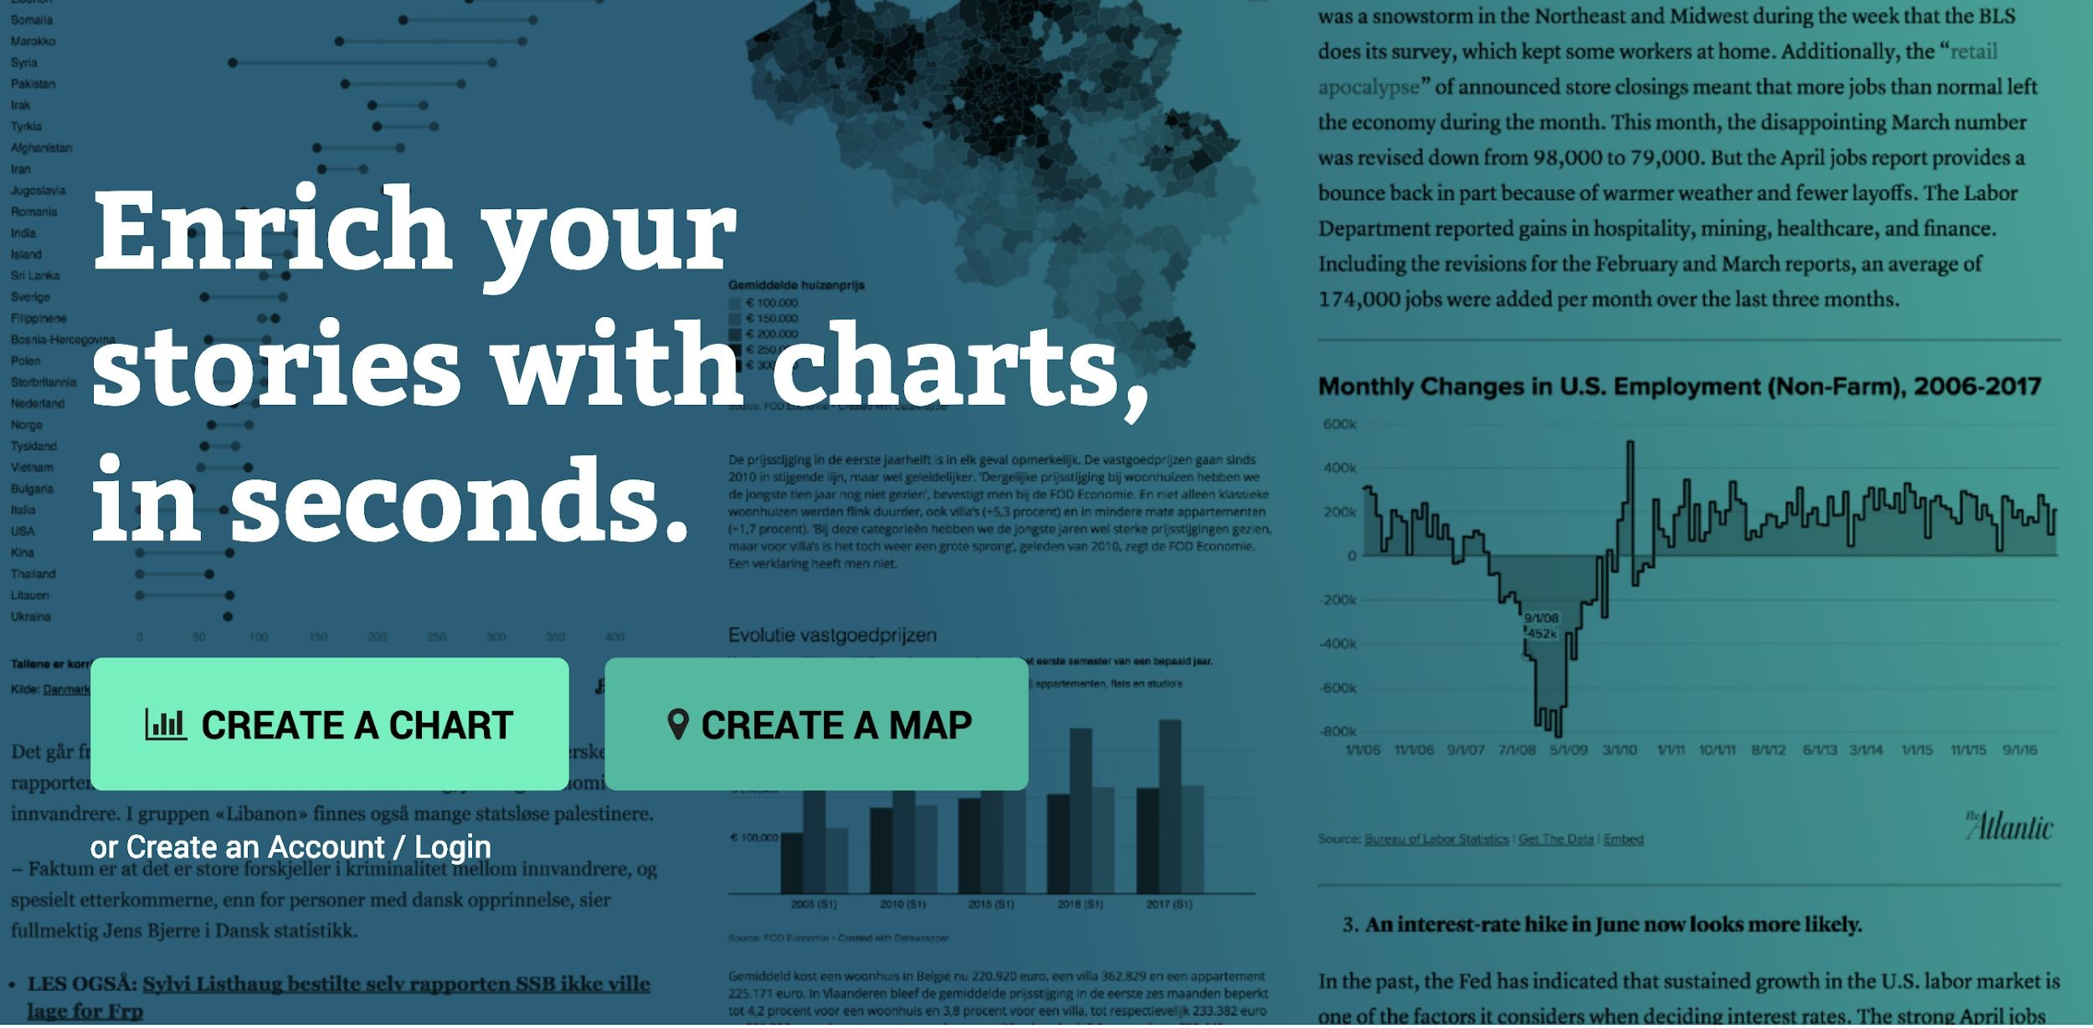
DataWrapper

Slide 10
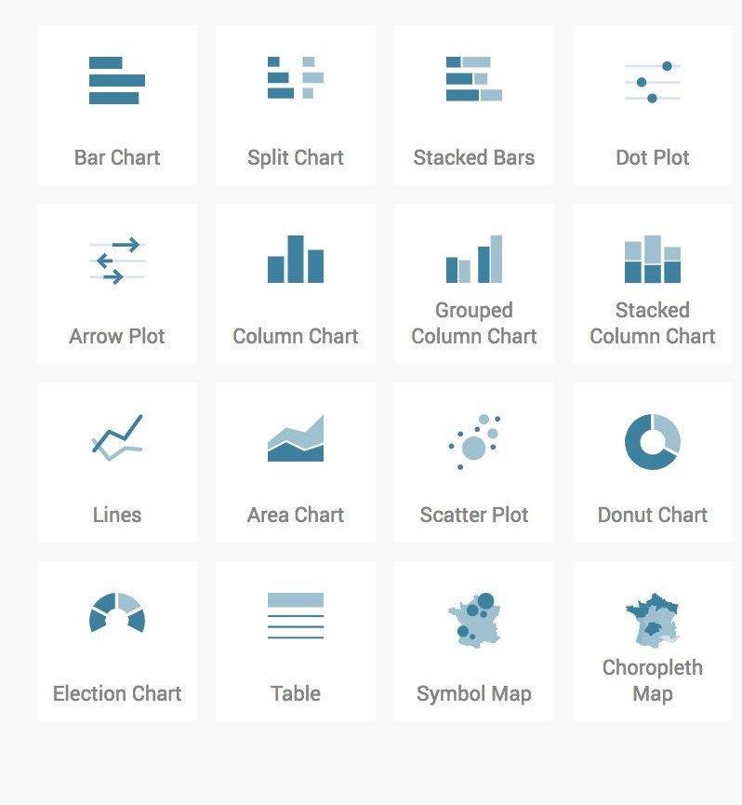
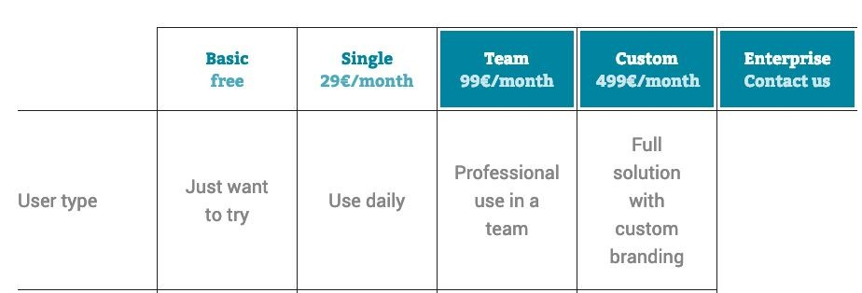
DataWrapper
Good choice of standard graphics
Maps
Simple styling and coloring options
Easily embed graphic
But: only trial version!

Slide 11
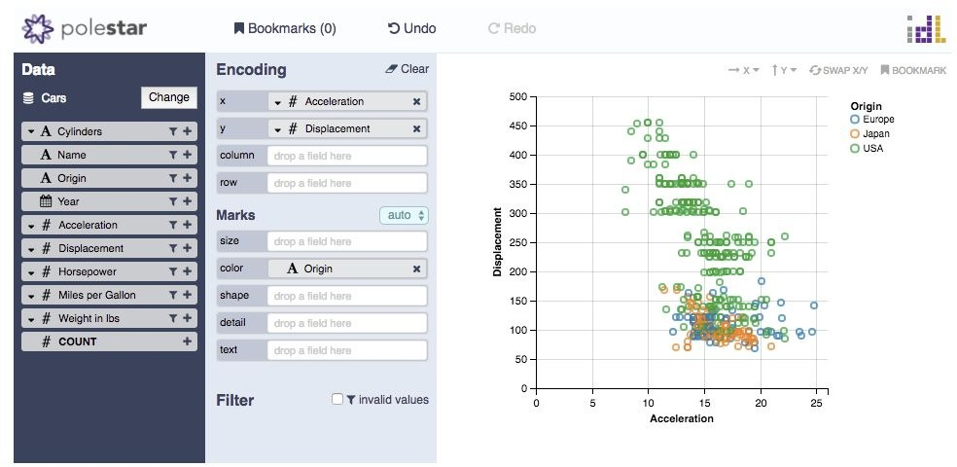
PoleStar / Vega
https:/ vega.github.io/polestar

Slide 12
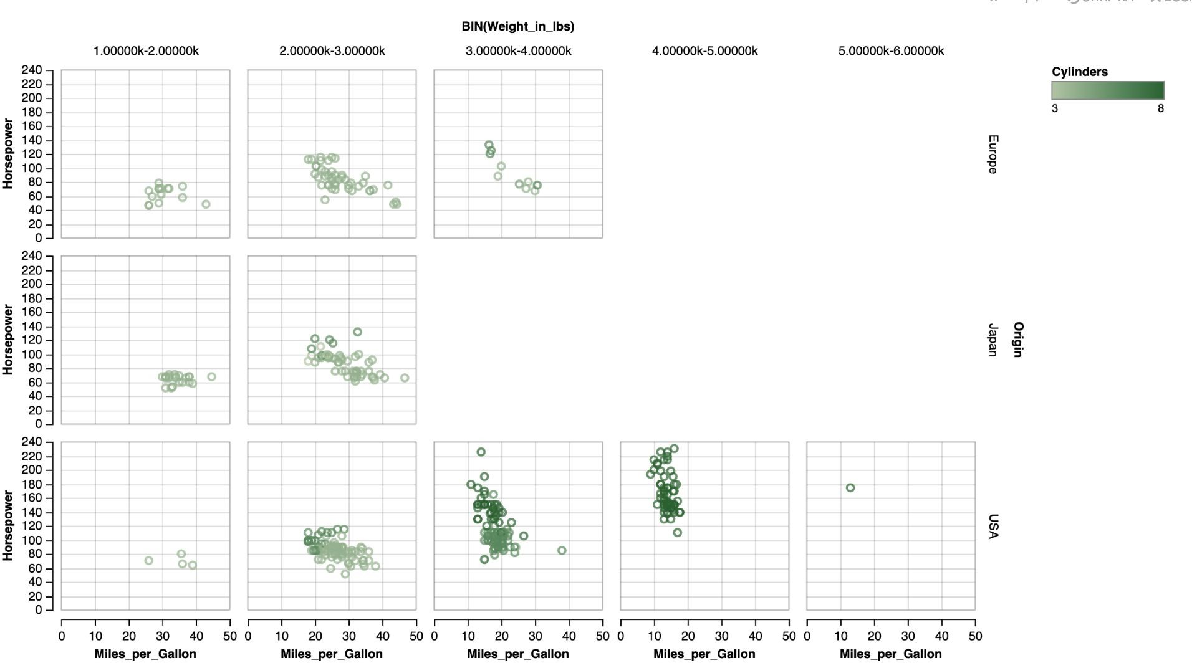
PoleStar / Vega
https:/ vega.github.io/polestar

Slide 13
Polestar Vega
Multivariate data
Very easy to use
Little interaction
Exports VegaLite specification

Slide 14
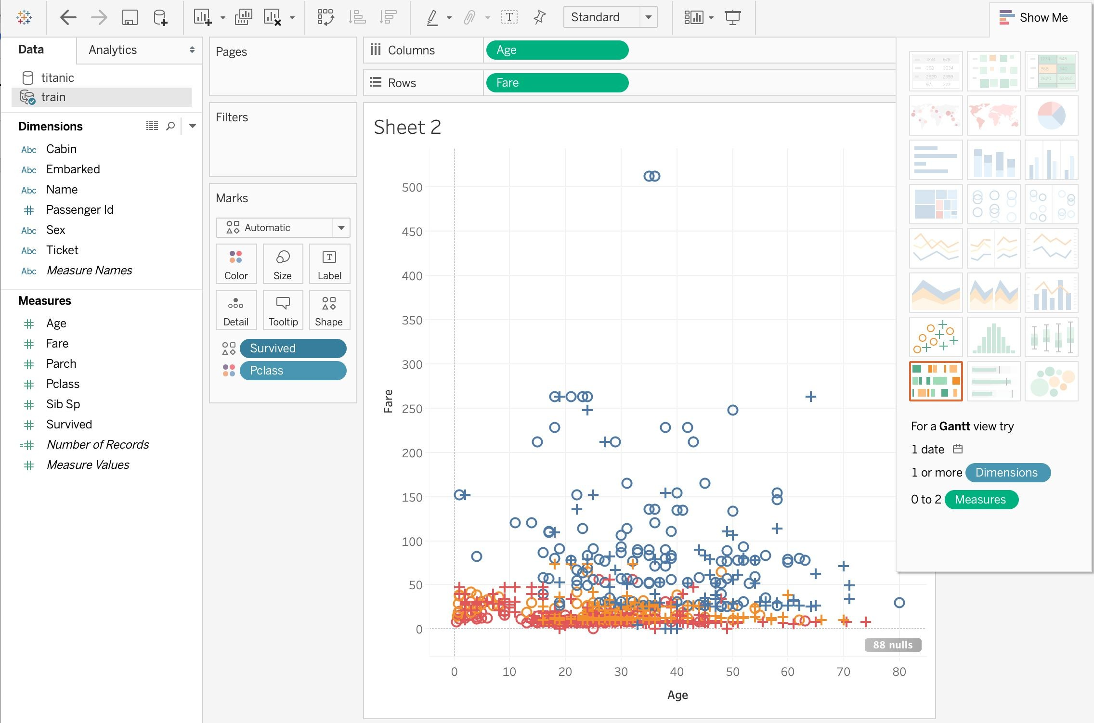
Tablau
https://www.tableau.com

Slide 15
Tableau
Simple drag and drop
Many functions (too many?)
Many standard charts like DataWrapper
Video tutorials
Free trail and online version
Targeted towards businesses

Slide 16
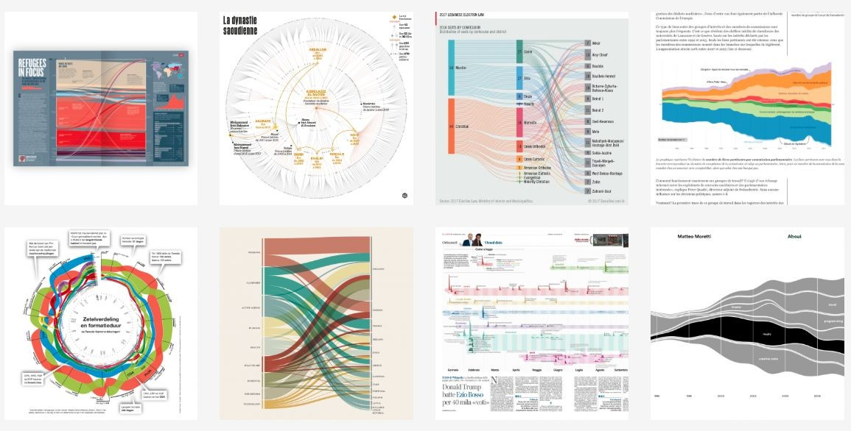
Raw Graphs
https:/ www.rawgraphs.io

Slide 17
Generic
Coding
Designing
Using
Speciﬁc

Slide 18
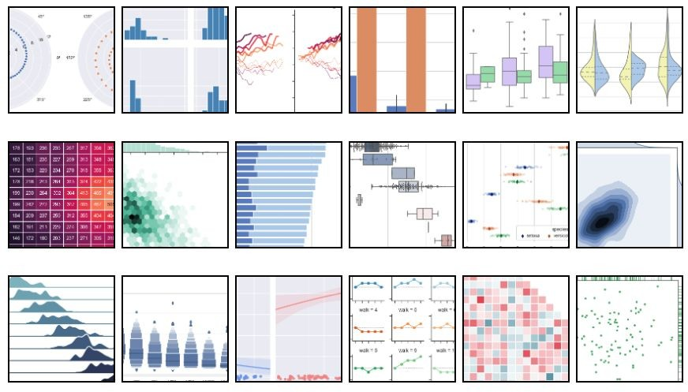
Python: Seaborn
Static images
Easy to program
Good choice of charts

Slide 19
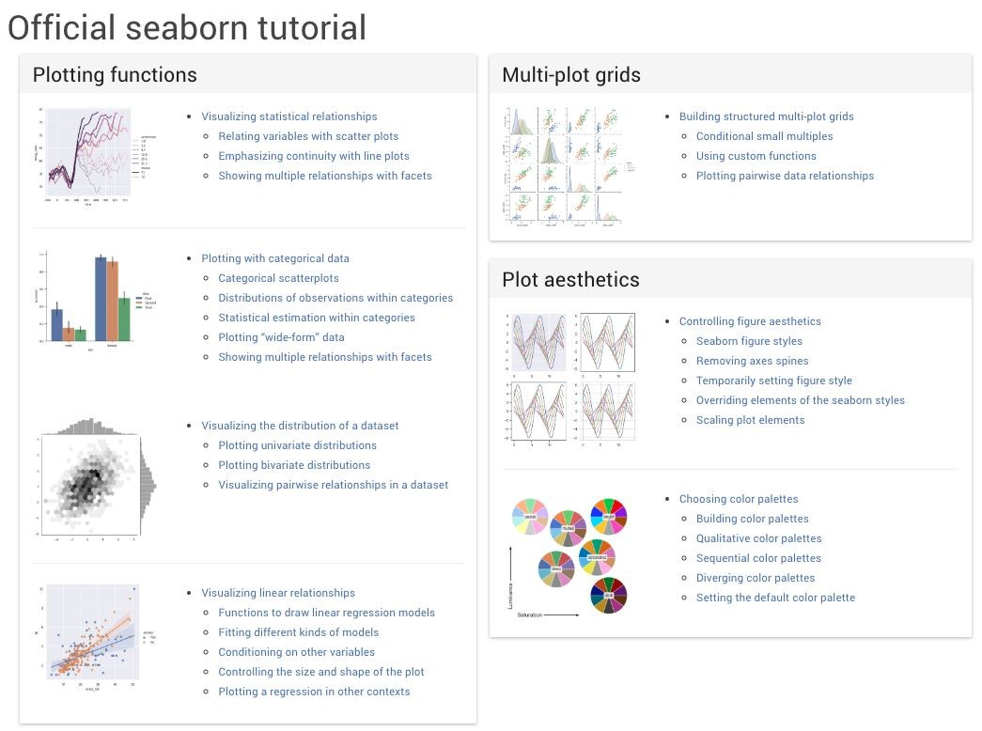
Python: Seaborn

Slide 20
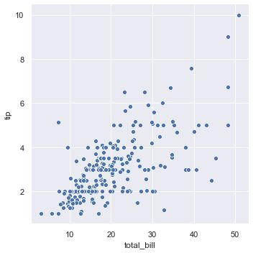
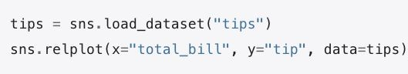
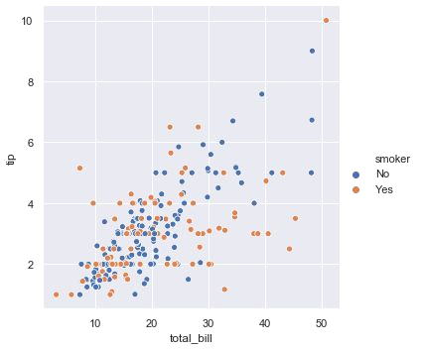
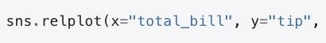
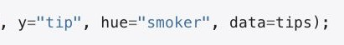
Python: Seaborn

Slide 21
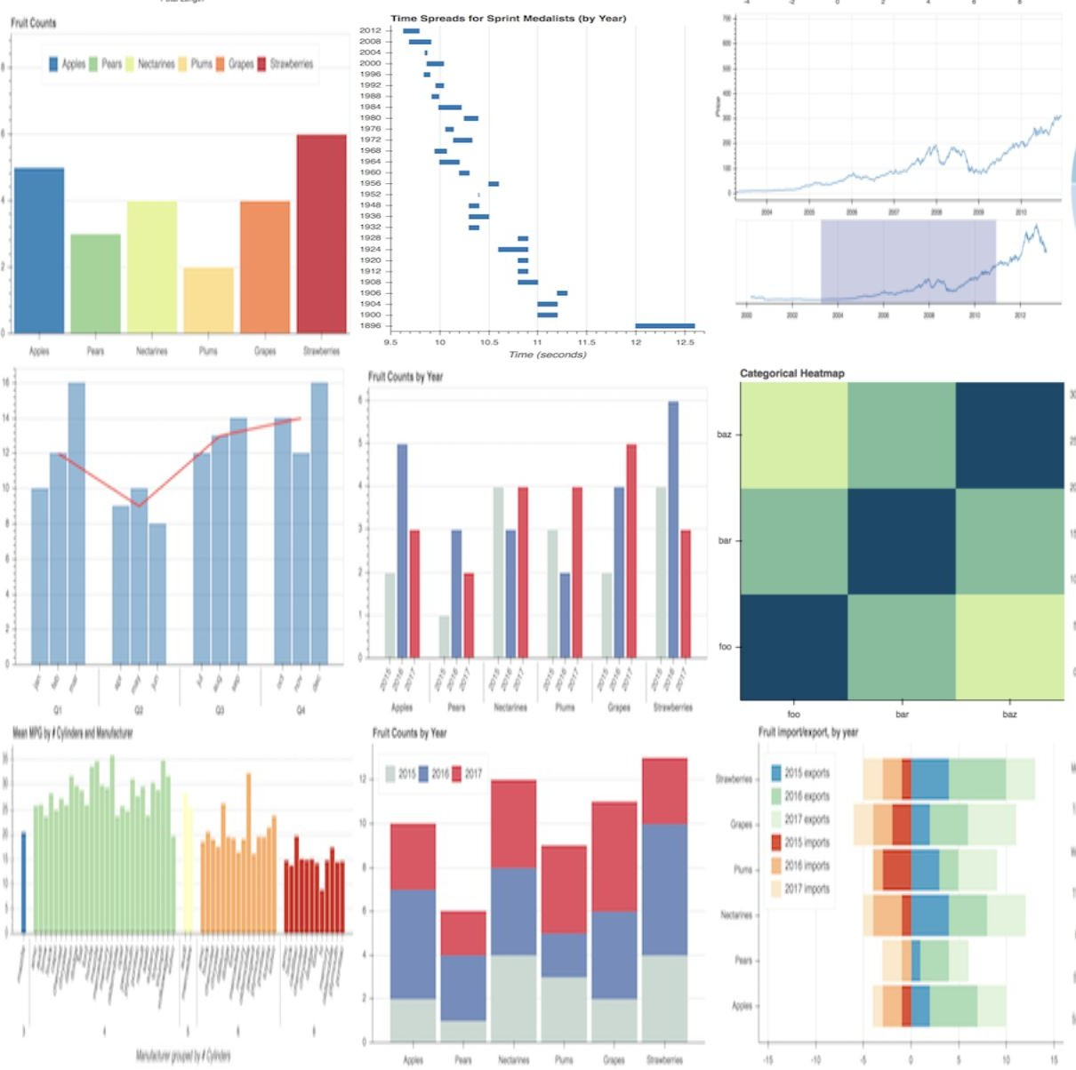
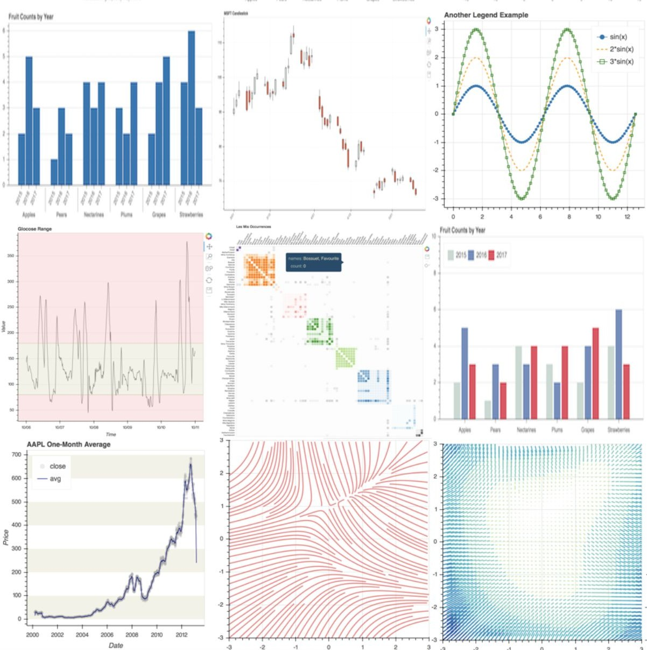
Python: Bokeh
Interactive graphics
Produces JavaScript and runs in browsers
Low-level control > sophistication
Interactive applications

Slide 22
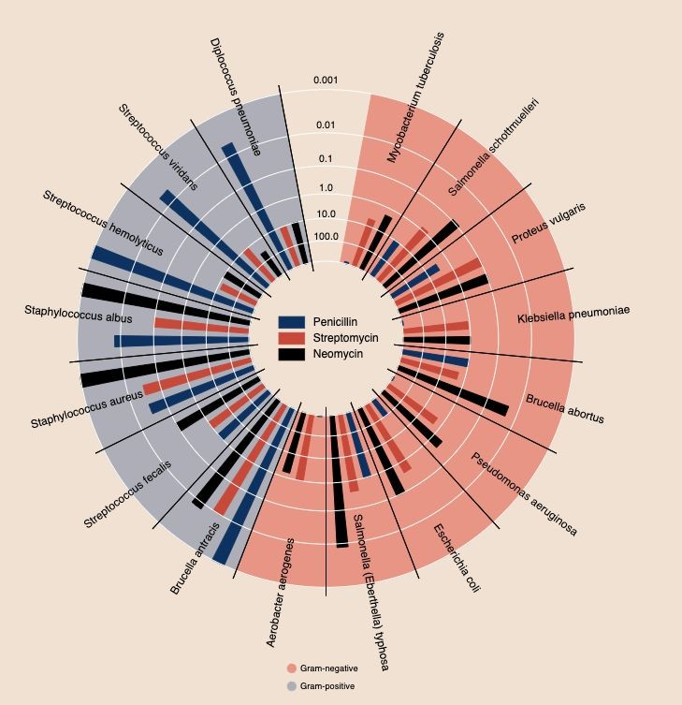
Python: Bokeh

Slide 23
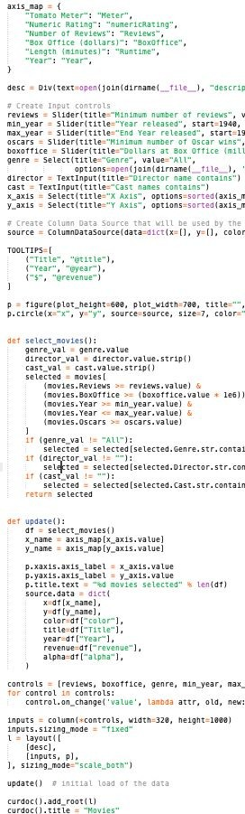
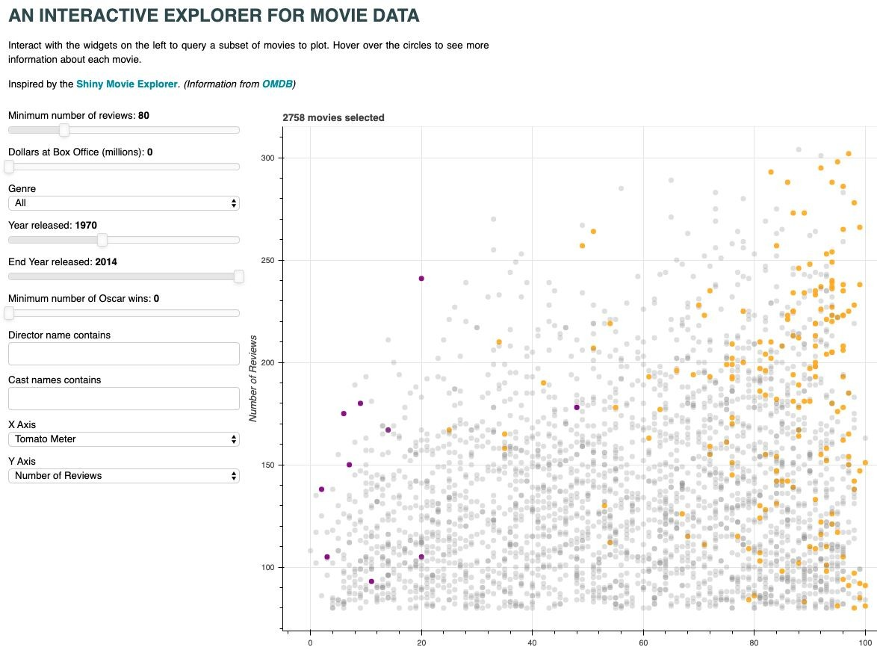
Python: Bokeh
https://demo.bokeh.org/movies

Slide 24
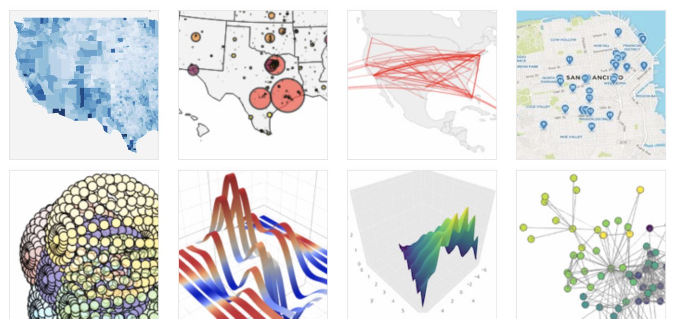
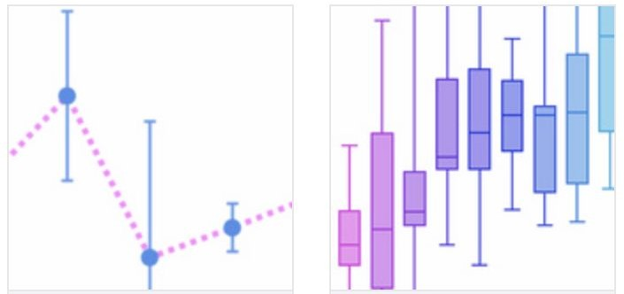
Plotly (Python, R, MatLab, Perl..) > JavaScript
Cross-languages
Interactive > JavaScript

Slide 25
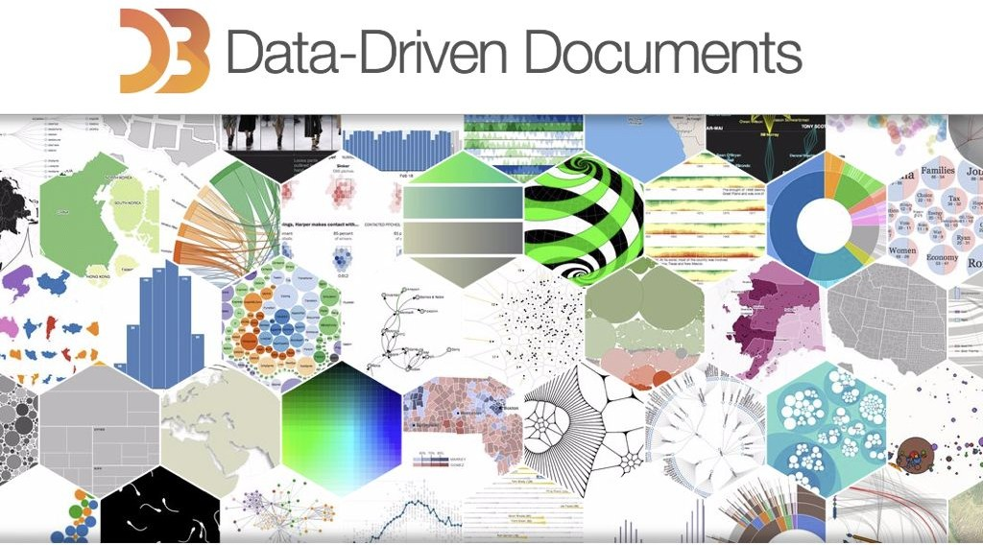
JavaScript: D3
http:/ d3.js

Slide 26
http:/ d3.js
JavaScript: D3
Importing (CSV, Json, etc..)
Objects (shapes) and visual attributes
JQuery based
Functions: interactivity, data transformation, layouts, geography, streaming, networks, scales, time, transitions, zoom, stats
Color scales
Good examples and huge community
- Tricky to learn

Slide 27
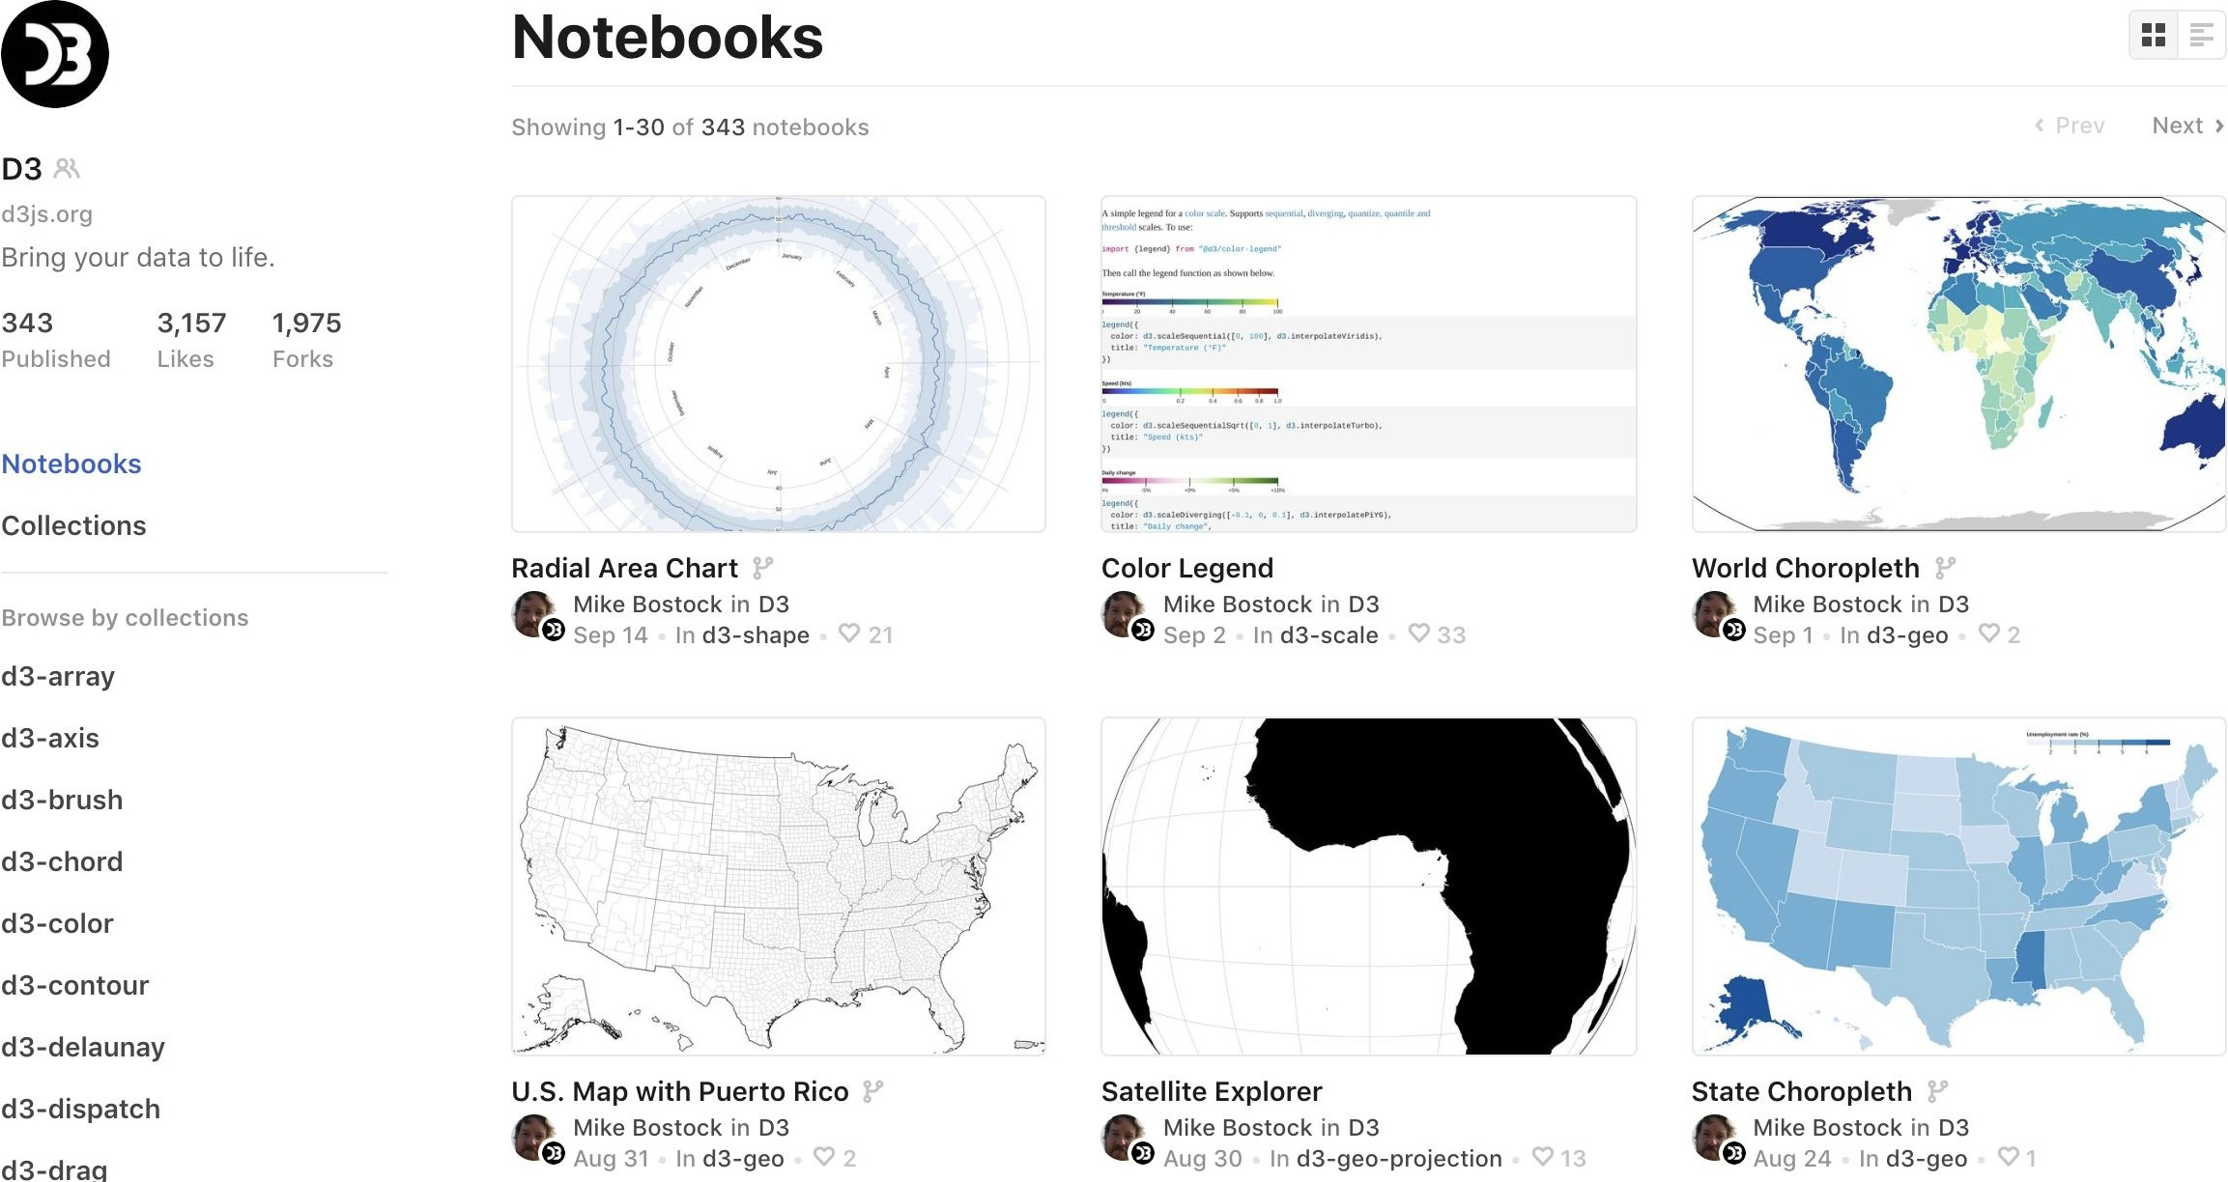
JavaScript: D3—Observable
D3 Live coding (like python notebooks)
https://observablehq.com/

Slide 28
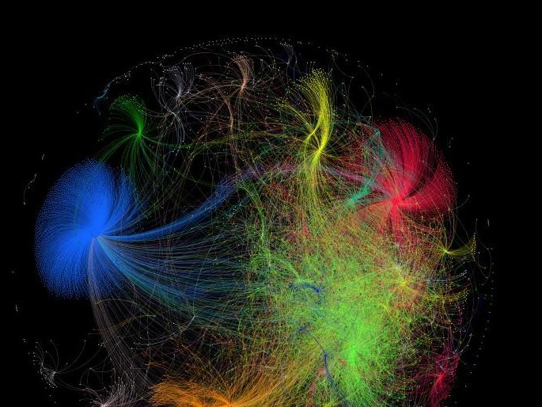
Gephi
https:/ gephi.org

Slide 29
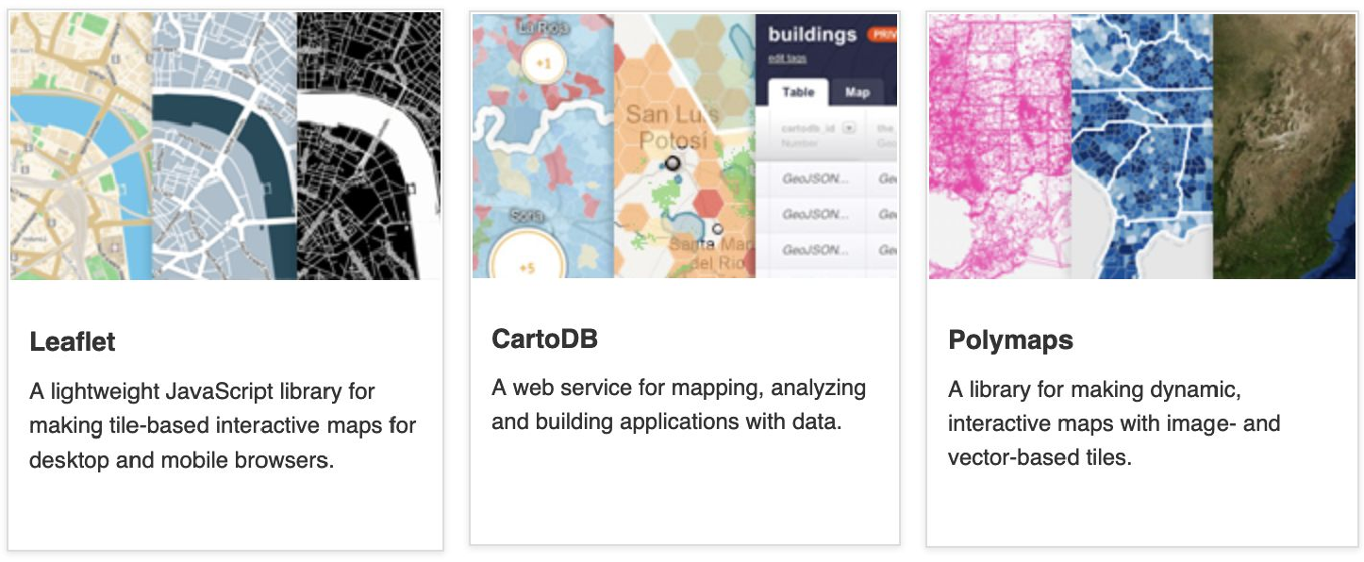
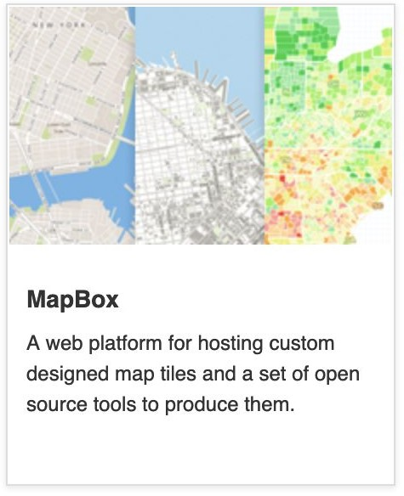
Geographical
Taken from: http://datavisualization.ch

Slide 30
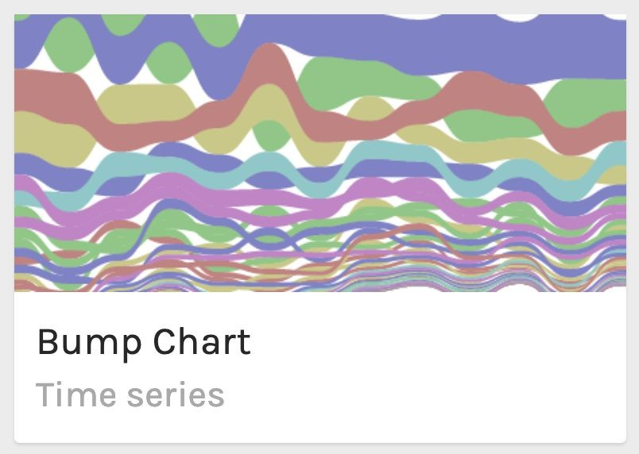
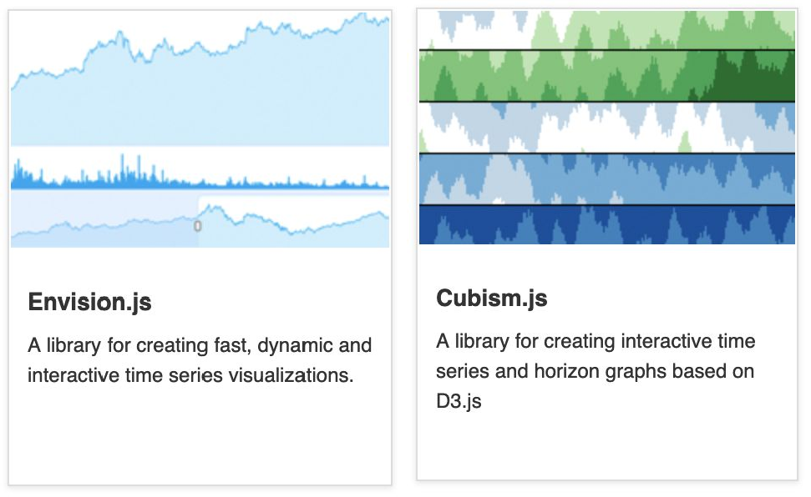
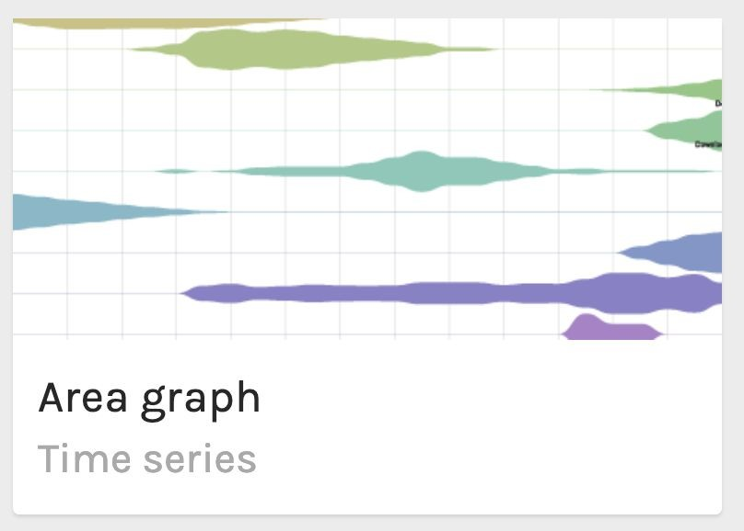
Temporal
Taken from: http://datavisualization.ch

Slide 31
Presentation & Design

Slide 32
RawGraphs
https:/ www.rawgraphs.io

Slide 33
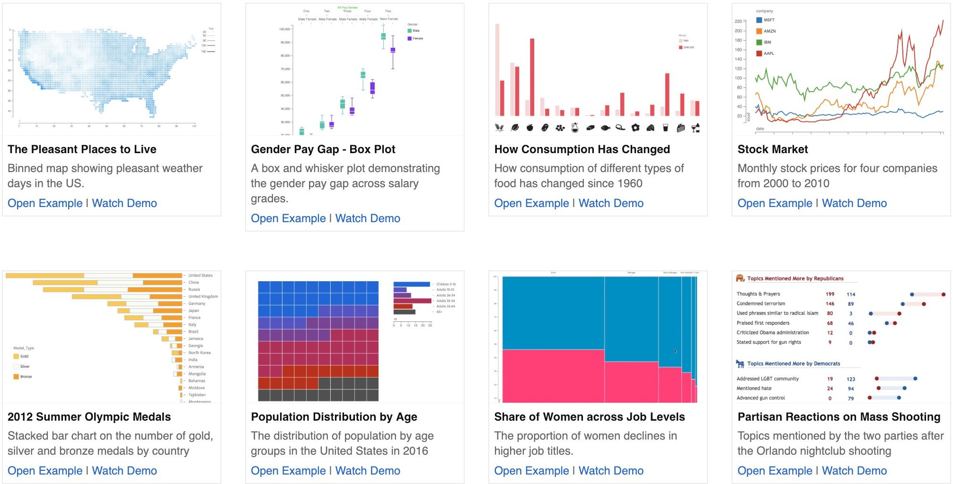
http://data-illustrator.com

Slide 34
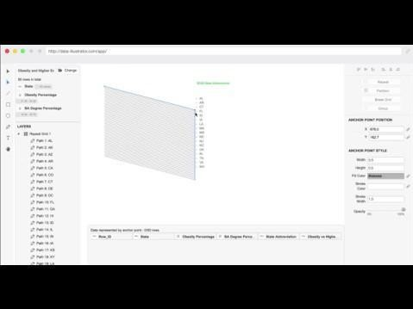

Slide 35
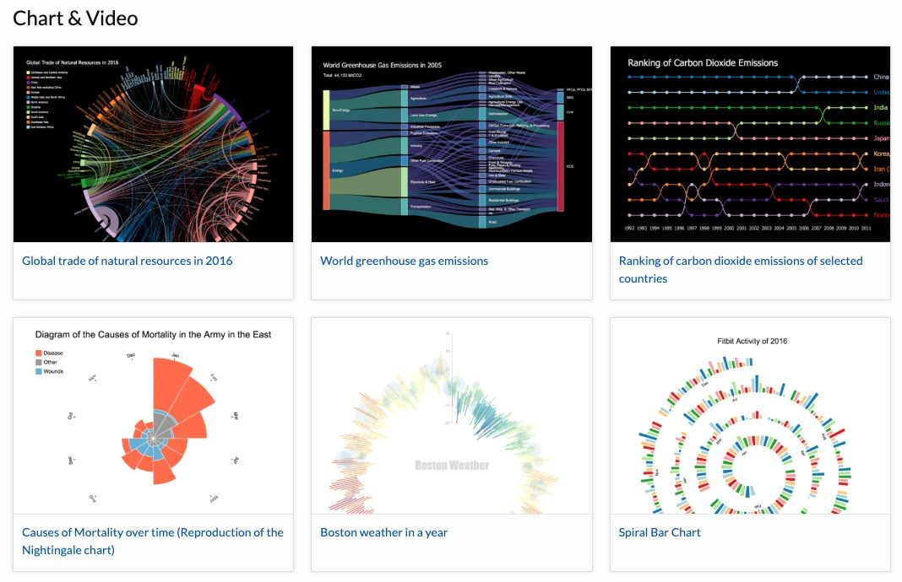
https://charticulator.com

Slide 36
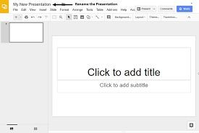
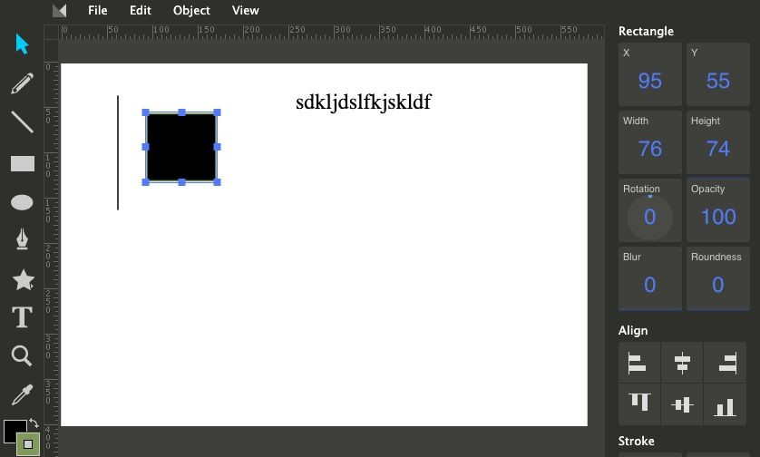
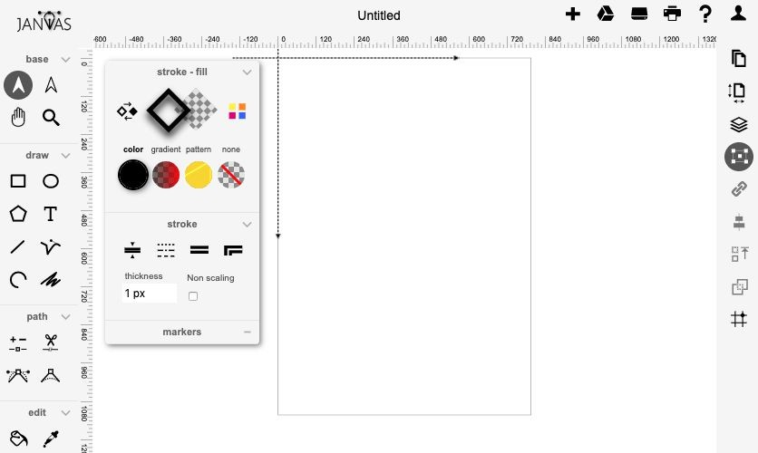
Vector Drawing
Google Slides
Method Draw (https://editor.method.ac/)
www.janvas.com

Slide 37
Recap
Simple & quick: Data Wrapper
Scatterplots + distributions: Polestar
Alternatively Raw graphs, but requires Illustrator pass
Python: Seaborn (static), Bokeh or Plotly (interactive)
Powerful & customized: D3 (start early!)
Graphs: Gephi, Palladio, Vistorian
Customized & no-coding: Data Illustrator, Charticulator
Vector tools

Slide 38
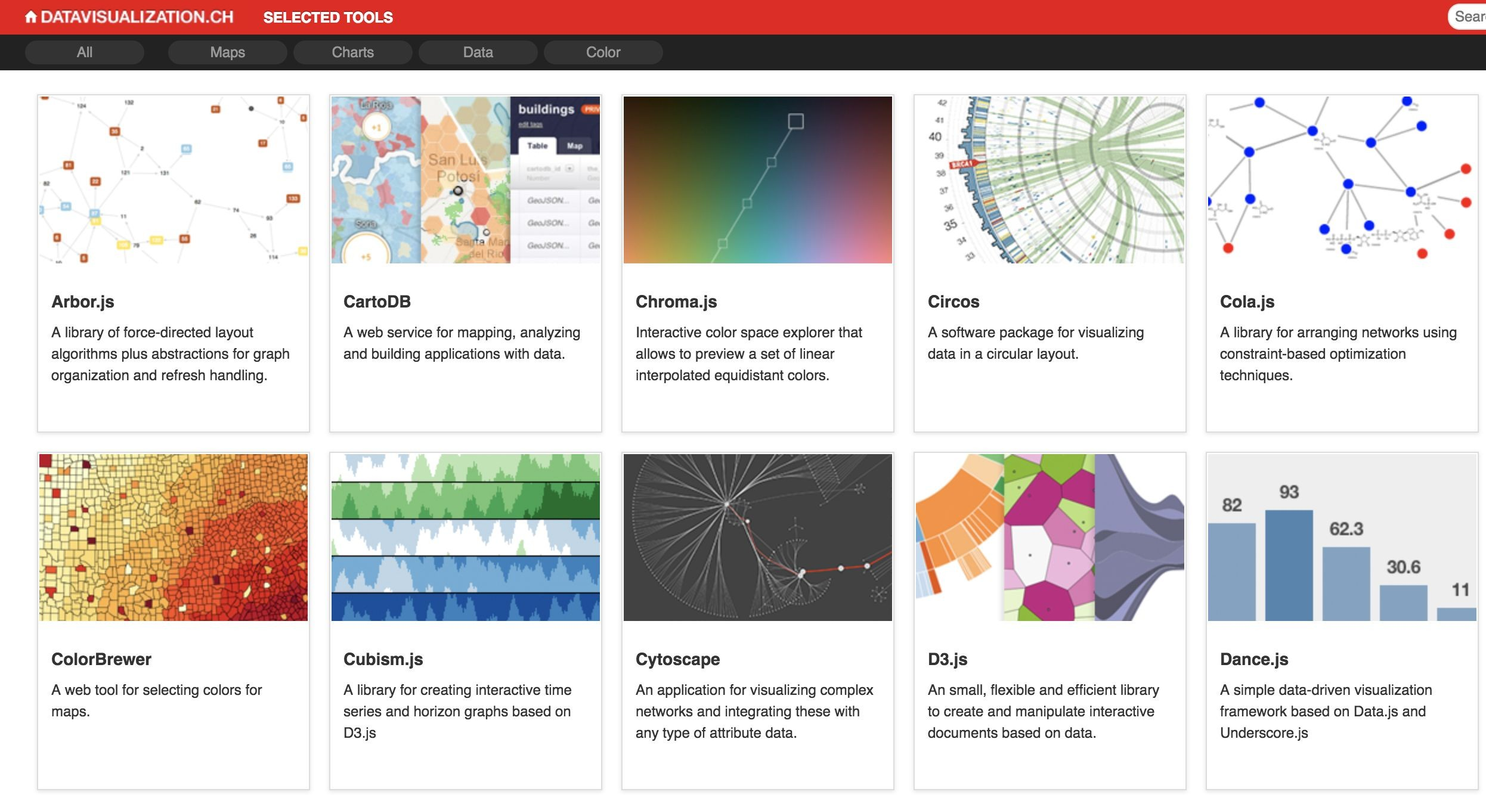
Datavisualization.ch

Slide 39
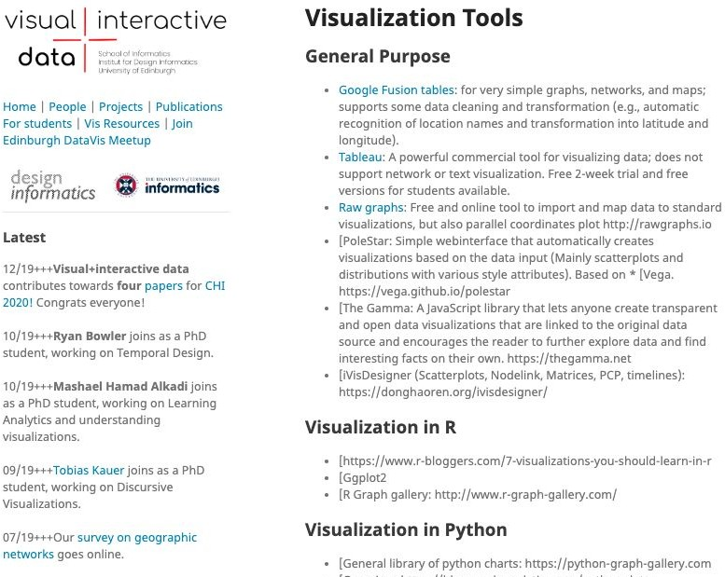
https://visualinteractivedata.github.io/res-tools.html

Slide 40
Sketching

Slide 41
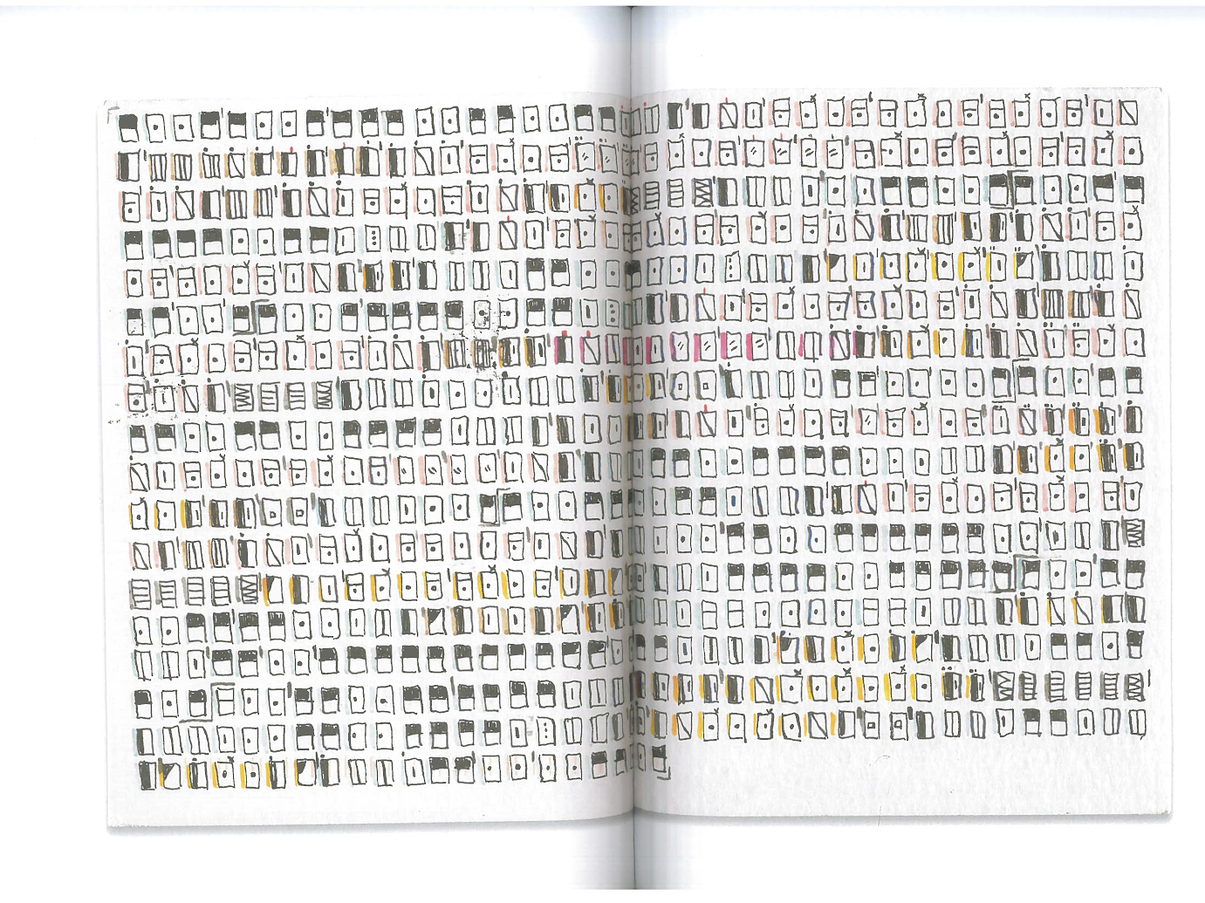
Sketching: Visual Marks

Slide 42
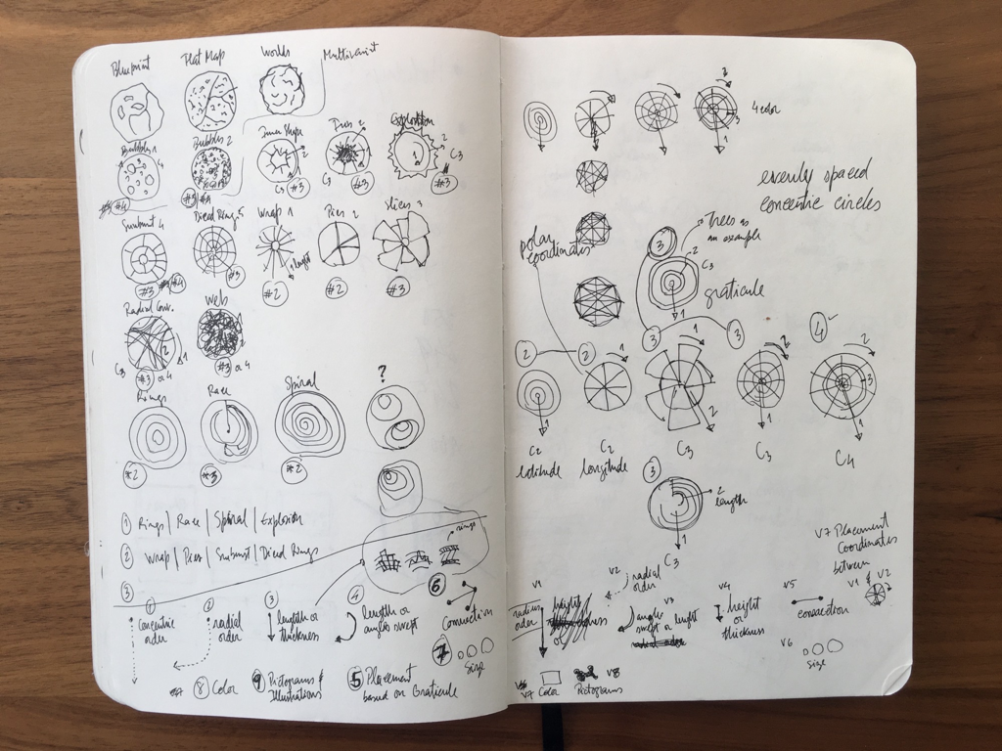

Slide 43
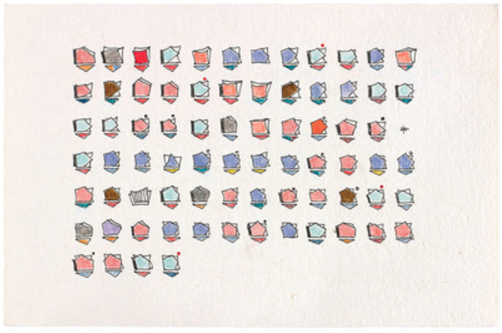
Dear Data
http://www.dear-data.com

Slide 44
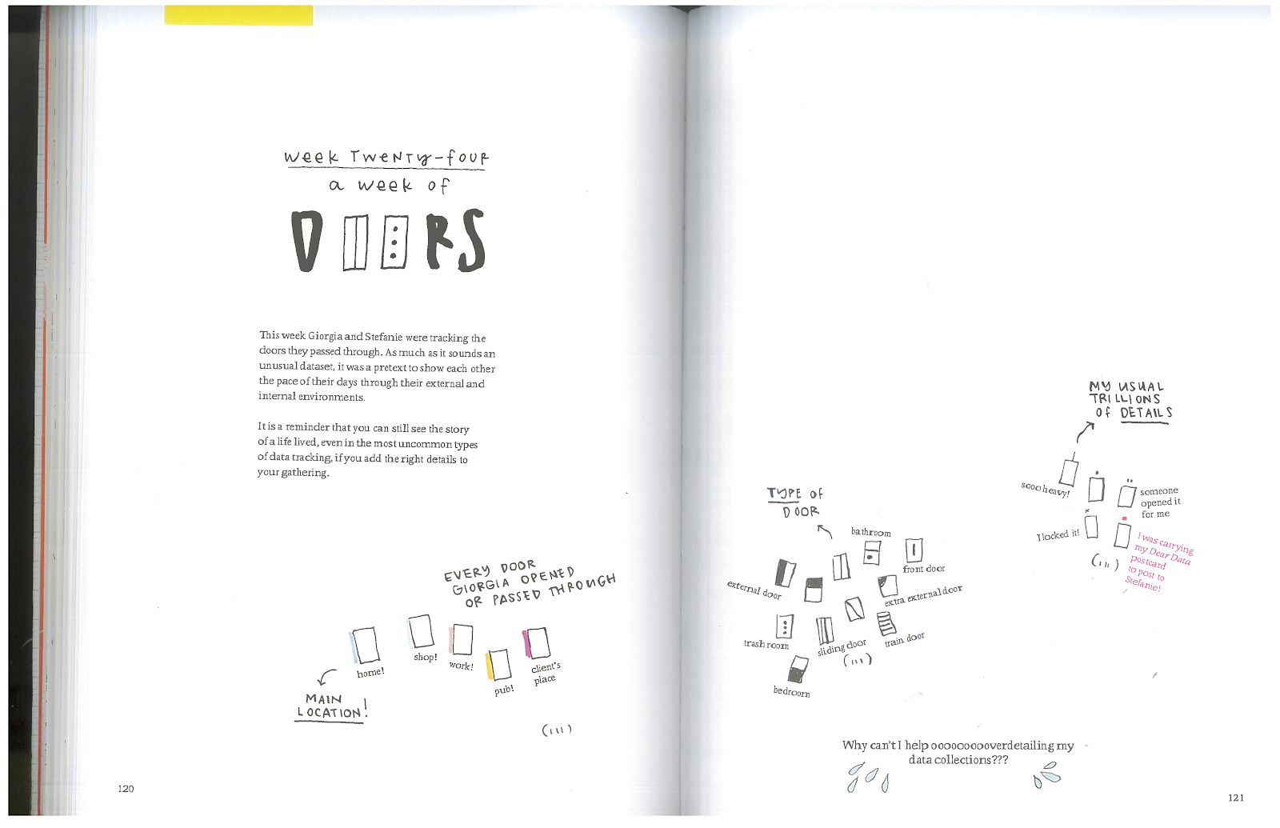
Sketching: Visual Marks

Slide 45
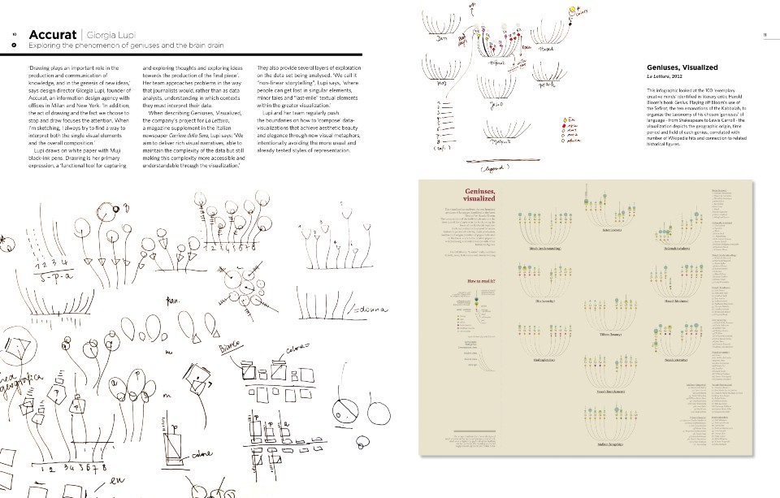
Sketching: Shapes and forms

Slide 46
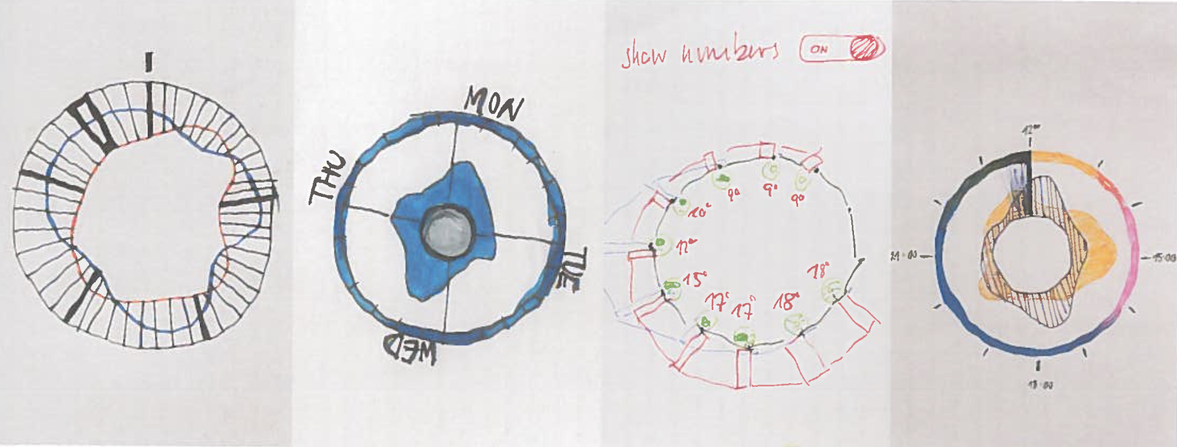
Sketching: Alternatives

Slide 47
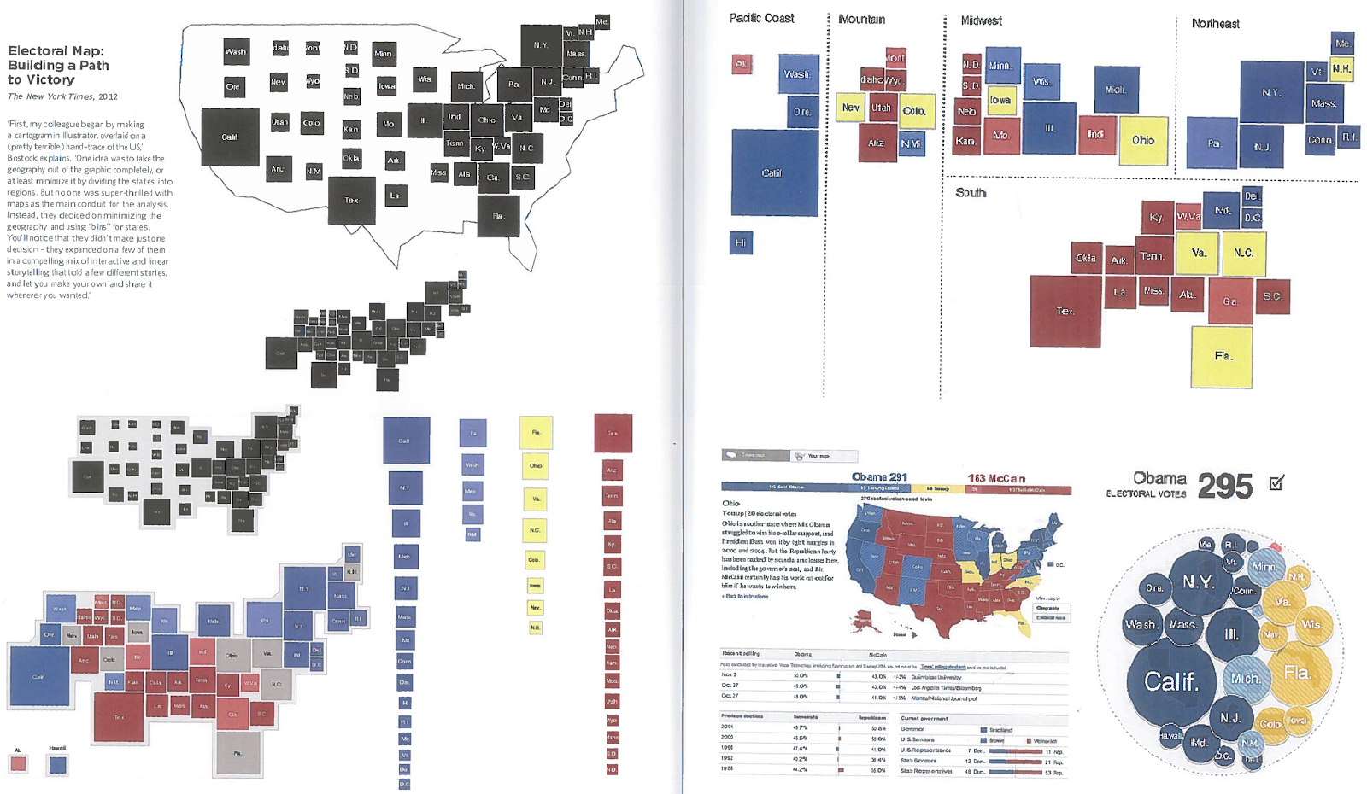
Evolution

Slide 48
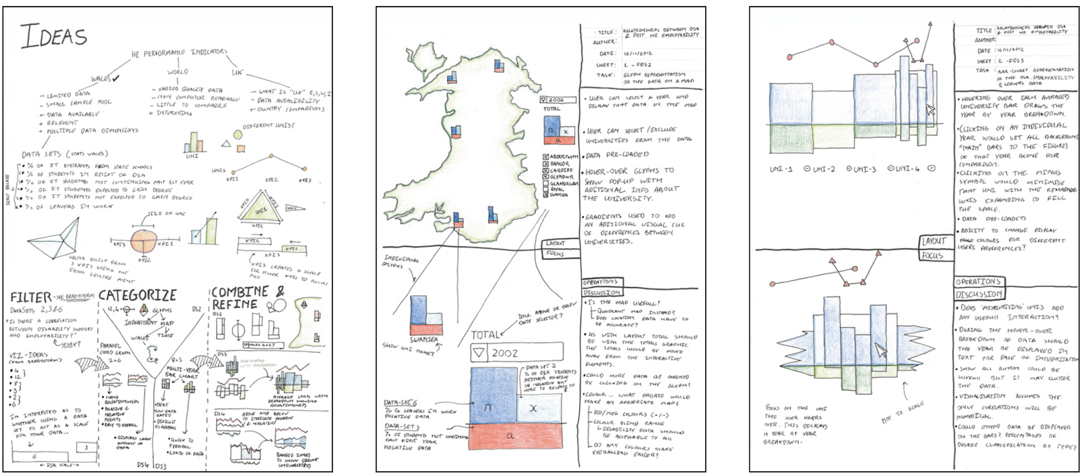
Sketching: Views and Layouts

Slide 49

How to think about data in 2023?

Slide 50
Machine Learning

Slide 51
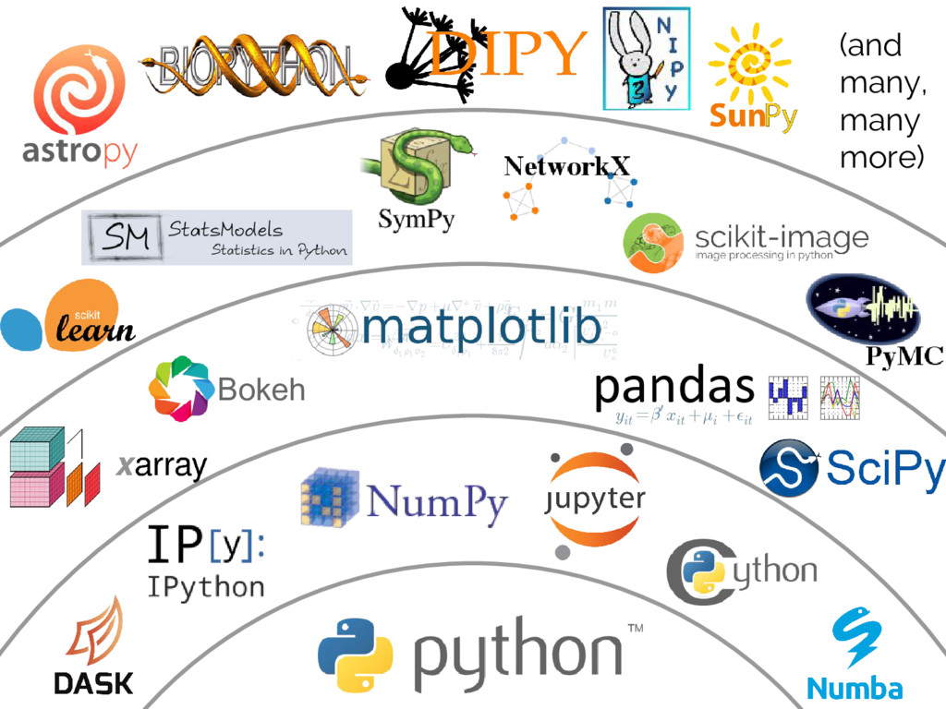
Aula 06:

Slide 52

You most learn: (scikit-learn Python library )
https://scikit-learn.org/stable/tutorial/machine_learning_map/index.html

Slide 53
Exercise
Load the breast cancer dataset.
Try to cluster it into two clusters and check if the clusters match with the target class from the dataset, which specifies if its malignant or not. Here we are testing if we can we idenitify if its malignant or benign without even looking at the target class i.e. using unsupervised learning.
Next, train a supervised classifier, a DecisionTreeClassifier, and see how much improvement we get?
bc = datasets.load_breast_cancer()
print(bc.DESCR)

Slide 54
Useful links!!!
Useful links!!!
In-depth introduction to machine learning in 15 hours of expert videos
https://www.r-bloggers.com/in-depth-introduction-to-machine-learning-in-15-hours-of-expert-videos/
Chapter 2: Statistical Learning Applied Exercises
http://rstudio-pubs-static.s3.amazonaws.com/203045_9744ef21cf43440e8aecc4abc284c6ad.html
Machine Learning – Intelligent Decisions based on Data
https://witanworld.com/article/2018/04/21/machinelearning/

Slide 55

ANY QUESTIONS?

